Slide 1
EE492 Senior Design Project ESTIMATION OF THE EFFECTS OF MATCHING LAYER ON WEARABLE AND IMPLANTABLE ANTENNAS USING GAUSSIAN PROCESS REGRESSION
By sefa kayraklık
Pı: sema dumanlı Oktar
Notes:
Hi everyone, I’m Sefa. I’ll be presenting my senior design project of estimation of the effects of matching layer on wearable and implantable antennas using gaussian process regression.

Slide 2
Content
Introduction
Circular loop antenna
Simulations in the presence of tissue
Dataset generation
Gaussian process regression model
Results
Notes:
Firstly, I’ll define what is a matching layer and why do we need this layer, then I’ll explain the antenna structure that is used in the project.
After showing the antenna, I’ll talk about the simulation setup and the dataset which I’ve generated.
Finally, in the last part, I’ll explain the estimation method of gaussian process regression and give the results.

Slide 3
Introduction
Why do we need matching layers?
Matching layer parameters: permitivitty and width.
Constructing a model to estimate the parameters which give the best performance.
Circular loop antenna working at 2.4GHz.
Notes:
The wearable and implantable antennas are very sensitive to their surronding. Since they are used near the human body, which is highly lossy, their performance, transmitted power, return loss, resonance frequency are negatively affected,. Therefore, their performance can be improved by placing a layer between the antenna and the human body.
So, we should determine matching layer’s permittivity, width, where to place the antenna and the antenna dimensions. One method to do that is running a lot of simulations then selecting the parameters that give the best results. However, this can take so much time. In determining the parameters, we can use a model which is constructed by a machine learning algorithm.
In the Project, for the antenna design, a circular loop antenna which work at the resonance frequency of 2.4GHz is selected. And the matching layer parameters are decided according to its simulations.

Slide 4
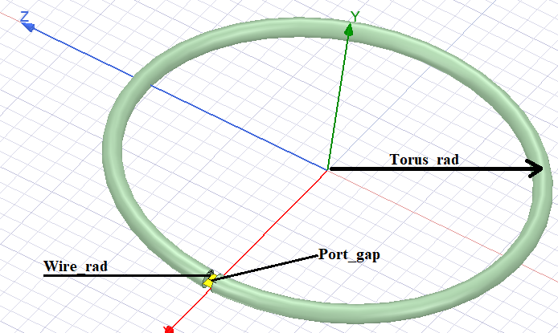
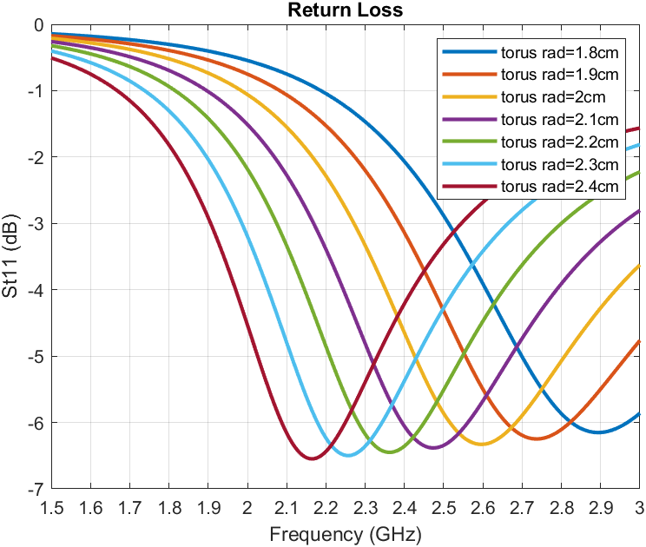
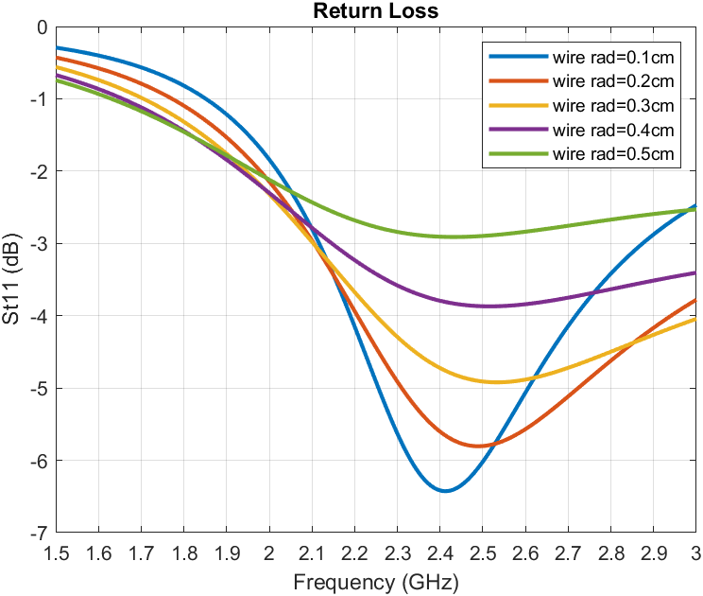
Circular Loop Antenna
The antenna is designed in HFSS.
It couldn’t be matched to 50 ohms.
So, a matching network circuit is used.
Notes:
The circular loop antenne is designed in a simulation platform of HFSS. The designed precedure of the Balanis’ antenna design textbook is followed.
In the first graph, the the radius is inreased while taking the width constant (0.1cm) and as expected the resonance frequency is shifting to right as decresing the size.
In the second graph, the effect of chaning the width is observed.
However, the input impedance of the antenna couldn’t be matched to 50 ohms by changing its dimensions, as seen the graphs.
So, a matching network circuit consisting of a capacitor and an inductor is used to match the antenna.

Slide 5
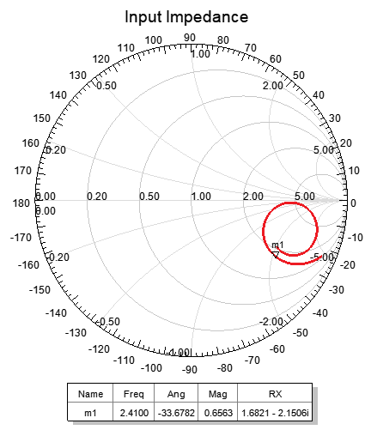
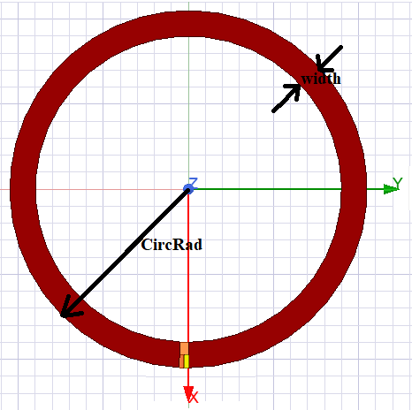
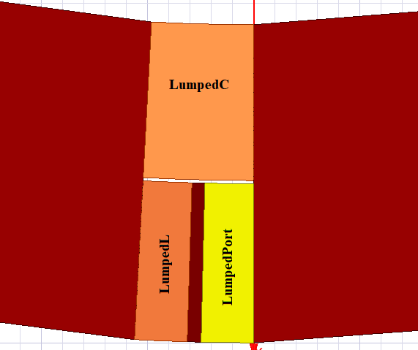
Circular Loop Antenna with Matching Network Circuit
The antenna and its port are redesigned.
The antenna input impedance is determined.
The values of capacitance and inductance are calculated.
Notes:
The circular loop antenna is redesigned as a planary stucture. Also, a matching network circuit is added its port.
The antenna input impedance is calculated to determine the values of capacitance and inductance in the matching network.
The values are calculated via an online impedance calculator.

Slide 6
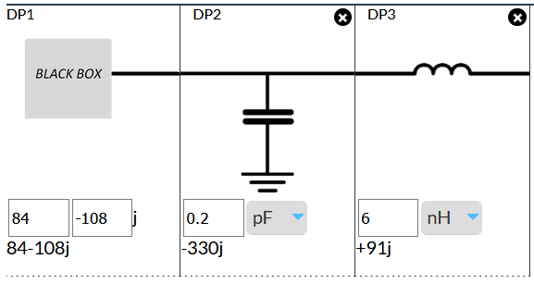
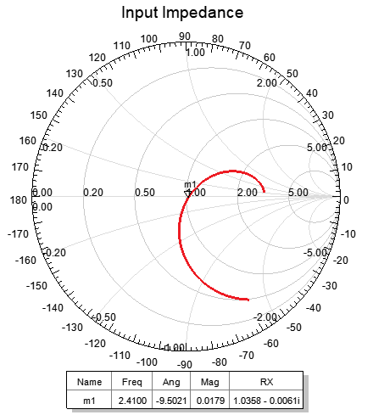
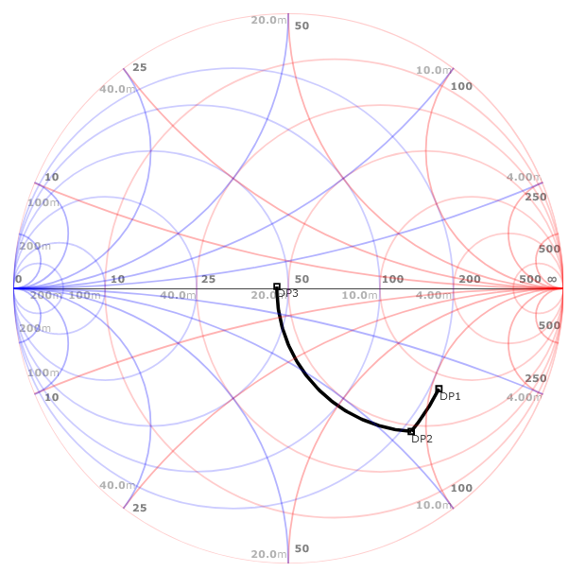
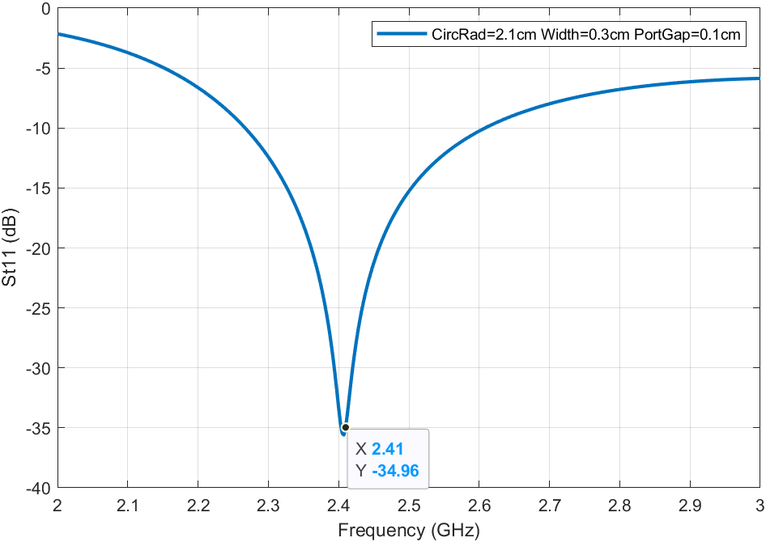
Notes:
The input impedance point of the antenna is on the right bottom of the chart, so first the point should be shifted to the 50 ohm circle with a parallel capacitor then it should be shifted to the center by a series inductor.
As seen in the return loss graph, the antenna is now matched to 50 ohms.

Slide 7
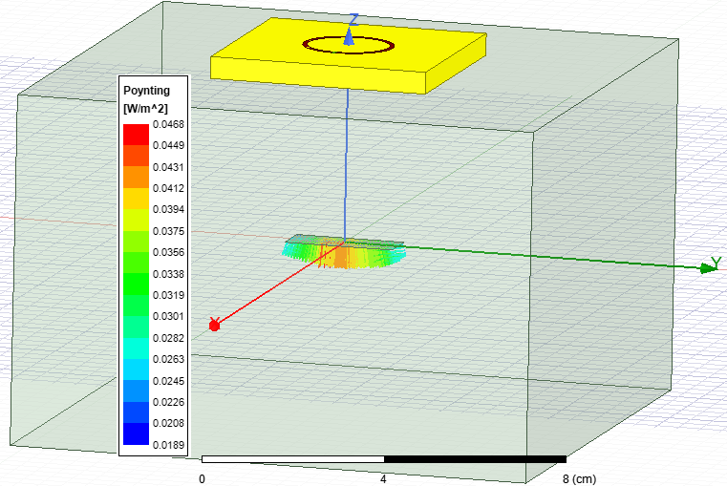
Simulation in the Presence of Tissue and Matching Layers
Four different simulation setups:
with only tussie layer and no matching network circuit
with only tussie layer and a matching network circuit
with both tussie and matching layers and no matching network circuit
with both tussie and matching layers and a matching network circuit
Notes:
The designed antenna is simulated in the presence of only tissue layer and both tissue and matching layers in order to observe the effect of placing matching layer. The light green box is the tussie layer and the yellow layer is the matching layer.
In order to observe the effects of adding a matching layer and matching network, four different simulation setups are constructed.
The detailed results for each simulation, are present in the final report. In the presentation, I’ll just mention the delivered average power to a rectangular at the origin.

Slide 8
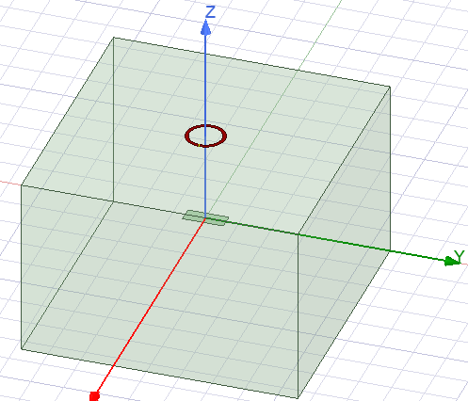
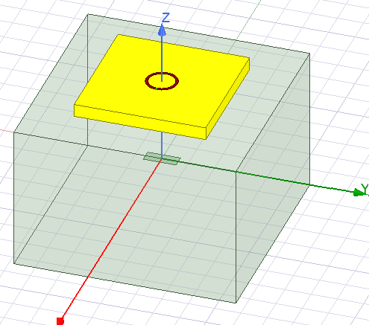
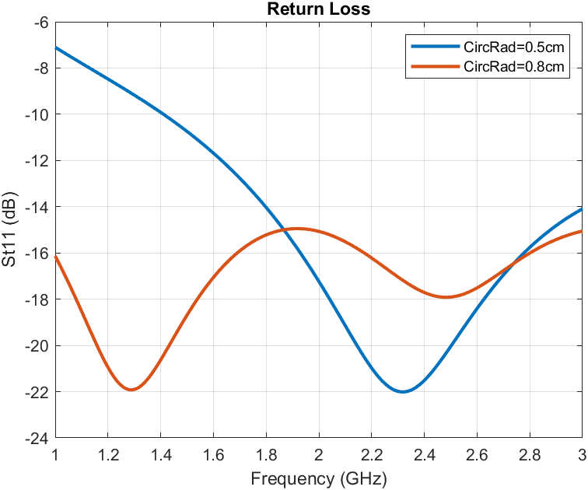
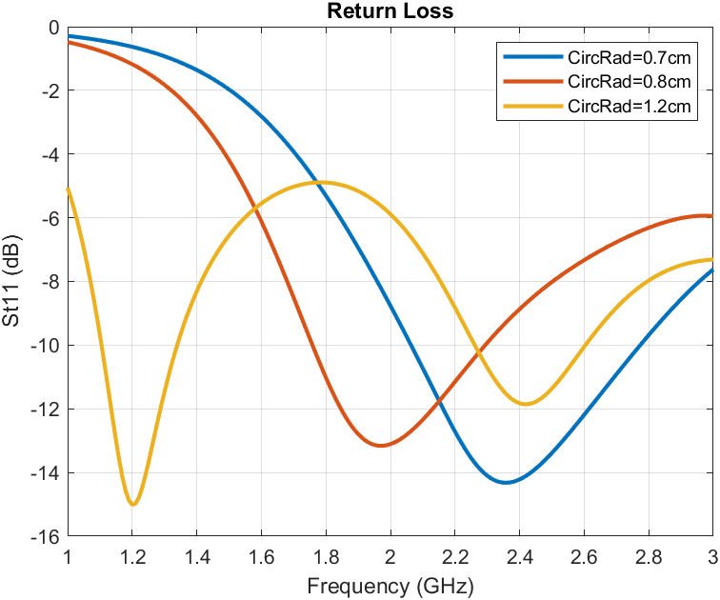
Notes:
The return loss graphs of only tussie layer and both tussie and matching layers with no matching network circuit are shown.
As seen in the graphs, the antenna can be matched without using a matching network circuit.

Slide 9
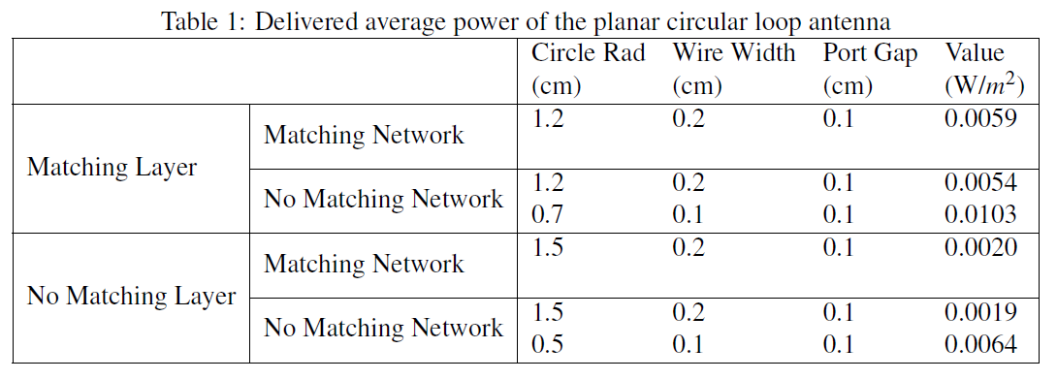
Delivered Average Power Calculation
The delivered average power is calculated using poynting vectors on a rectangular surface.
Matching layer improves more than matching network does.
Notes:
Delivered average power is calculated by integrating the poynting vector allover the rectangular surface and then dividing to the rengtangular area.
As seen in the table, the matching layer increases the power by almost 2 times, and the matching network increases only by 10 percent.
The improvement made by the maching network is not so much and it adds so much complexity, we need to determine the values of capacitance and inductance for each simulation. So, in the further simulations, only matching layer will be used to simplify the simulation setup.

Slide 10
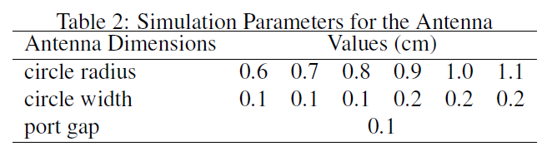
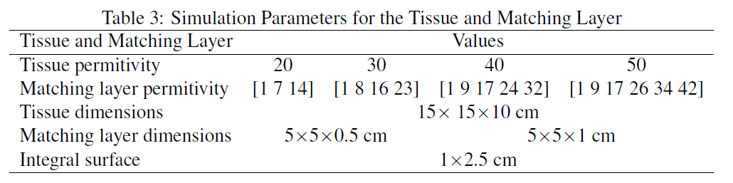
Dataset Generation
Dataset to train the machine learning algorithm.
6 antenna, 18 tussie and matching layer combinations.
S parameter sweep for S11 values at 2.4GHz.
Far field sweep for delivered average power.
Notes:
A dataset is generated using HFSS. Six different antenna combinations and eighteen different pairs of tussie and matching layer combinations and two matching layer width are simulated. A total of 2 hundred sixteen points of simulations are done within almost twenty four hours.
Two outputs are extracted from the simulations: the S11 values from s parameter sweep and the delivered average power from far field sweep. These results are saved to a file and read from a matlab script to train the estimation models.

Slide 11
Gaussian Process Regression Model
Probabilistic supervised machine learning approach.
Gives the uncertainty measurement of estimations.
2 estimation models:
To estimate S11 values with antenna dimensions and tissue and matching layer parameters.
To estimate delivered average powers with S11 values and the remaining inputs.
MATLAB Regression Learner App is used.
Notes:
In the project proposal, I mentioned that the machine learning method of an artificial neural network approach will be considered as an estimation model. However, I couldn’t construct a working network. I also mentioned that if the proposed method will not work, then the estimation method will be altered to new one. So, I tried to build a regression method to estimate the S11 values and delivered average power.
Since the relation between the input parameters and the outputs are not linear, the simple regression doesn’t perform well. So, more sophisticated regression of Gaussian Process is considered. It is a probabilistic supervised approach which gives the uncertainty measurement of estimations.
2 models are constructed: the first model is to predict the S11 values in terms of the input parameters and the second model is to predict the delivered average power by using the input parameters and the estimated S11 values.
MATLAB regression learner is used to build the models.

Slide 12
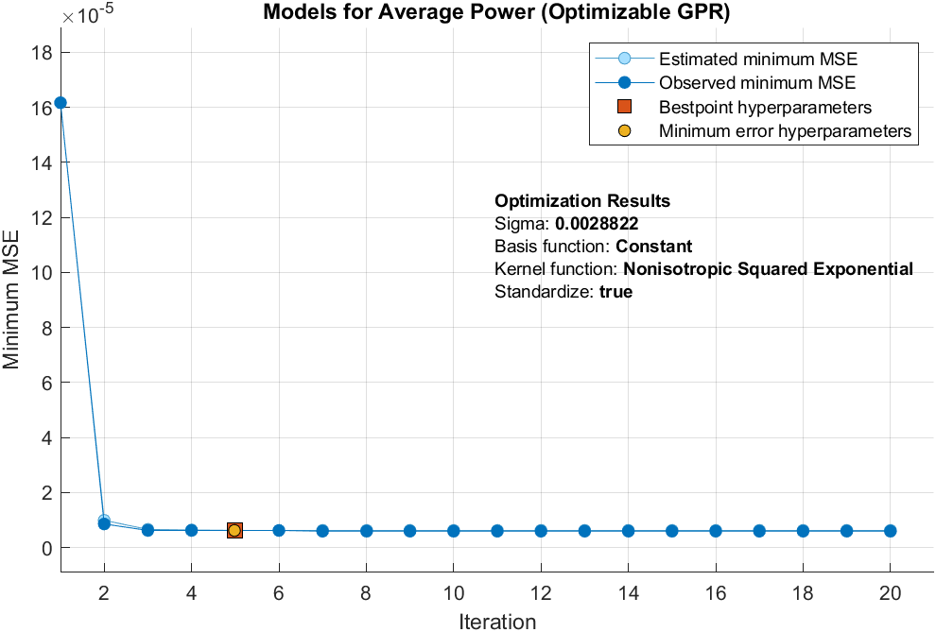
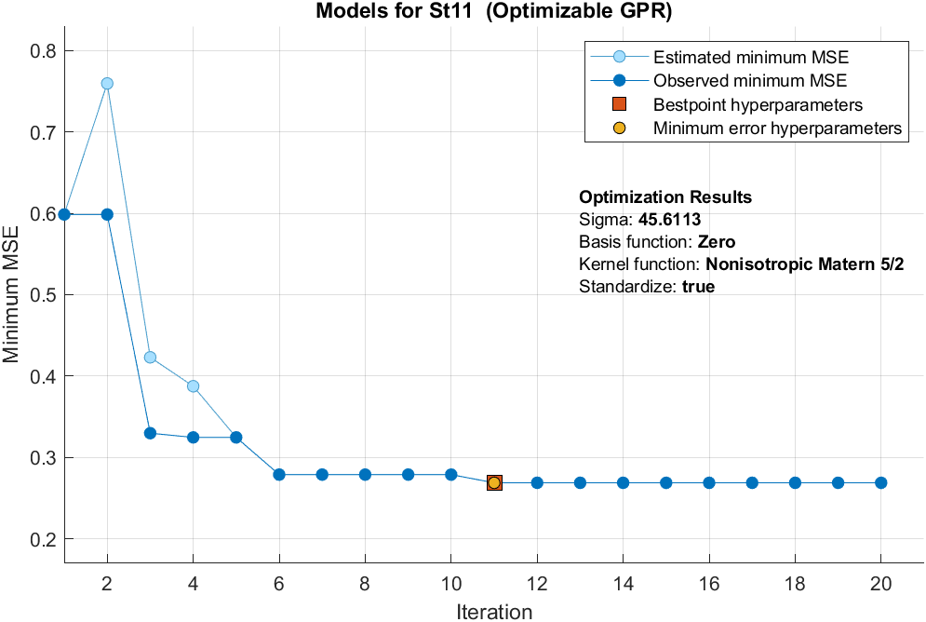
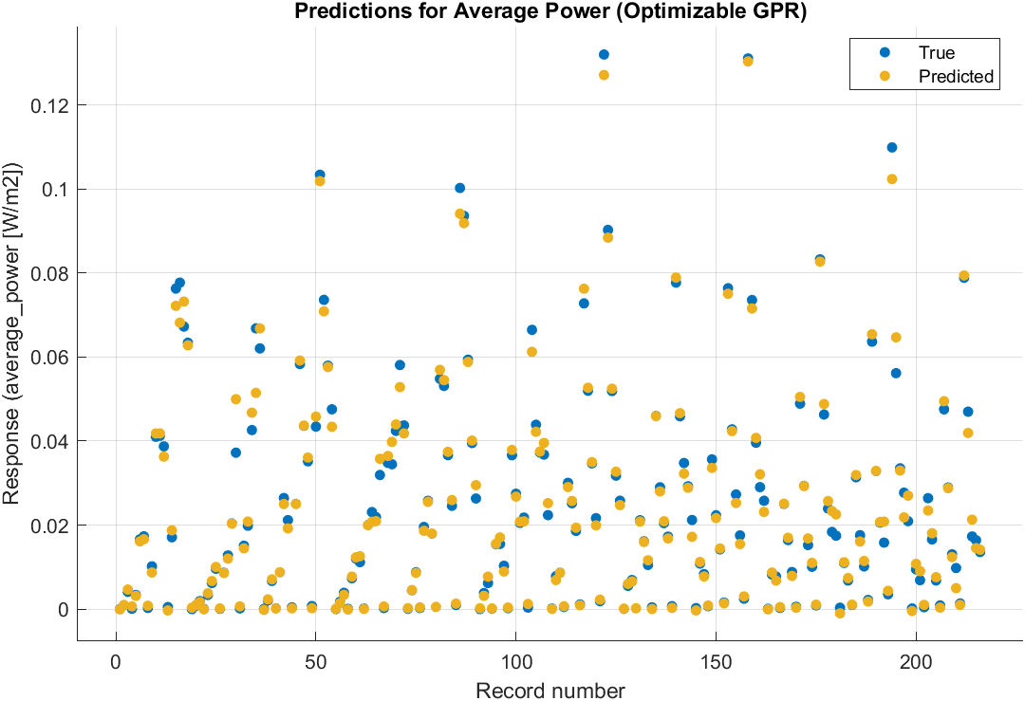
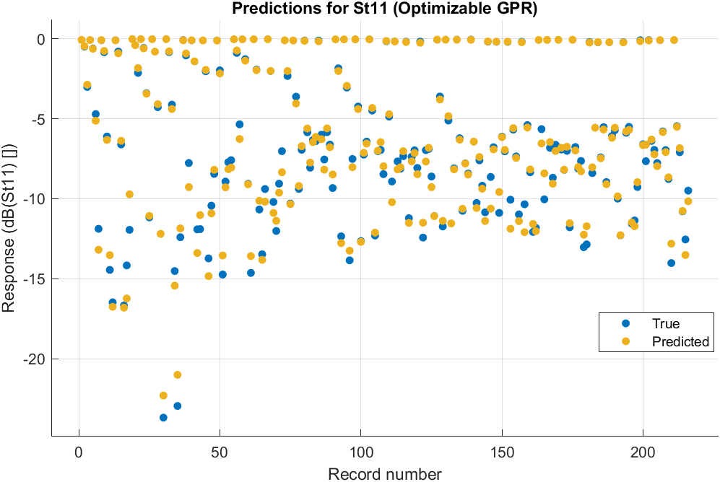
Notes:
In the regression learner app, the optimizable gaussian process regression is used. Each iteration, the app is trying to optimize the hyper parameters of the regression model and selects the one which gives the minimum mean squared error.
In the following graphs, the predictions and the true values of the outputs are given.

Slide 13
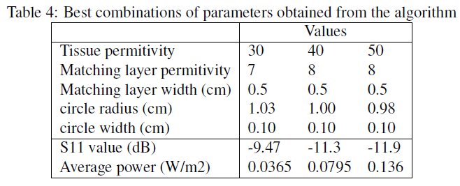
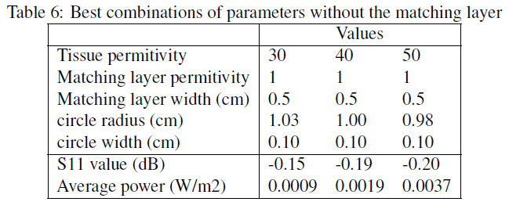
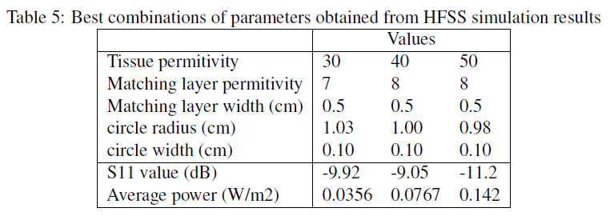
Results
Predicted values are very close to simulation values.
Placing the matching layer improves the performance of the antenna.
Notes:
It can be seen from the table 4 and 5 that the estimations of the delivered average powers which are made by the Gaussian process regression are very close to the simulation results.
In order to see the effects of placing the matching layer, the results without a matching layer are given in the table 6. As seen, without the matching layer, the antenna is not even matched.

Slide 14
Thanks for listening.

